Slide 1

Senior
Conferences
Congratulations Class of 2023!
Notes:
Greetings Class of 2023! My name is Mrs. Crutcher and I am the A-CL alpha counselor. Today you will have the opportunity to review your graduation checklist and review your transcript. The transcript shared with you today was printed prior to Friday, September 30 when the new rankings were shared. Please email me and I will be more than happy to share that information with you. You will be able to keep the transcript, however; the graduation checklist will need to be returned to a counselor after today’s presentation. This presentation will provide you with a wealth of information pertinent to your Senior journey. Let’s beginning by introducing Athens Dynamic School Counseling Team.

Slide 2
Who is my Counselor?
A-Cl Mrs. Crutcher acrutcher@wcpss.net
Co-Ha Ms. Huber lhuber@wcpss.net
He-Mc Mrs. Dickson kadickson@wcpss.net
Me-Sam Mr. Grabiec mgrabiec@wcpss.net
San-Z: Mrs. Hegarty chegarty@wcpss.net

Slide 3
Important Names to Know
Dean of Students- Ms. Pearson, jnpearson@wcpss.net
Student Services Assistant Mr. SanGiacomo (Coach Mike),
msangiacomo@wcpss.net
Intervention Coordinators- Mrs. Stephenson, astephenson4@wcpss.net
& Mr. Harmon, charmon2@wcpss.net
Registrar- Mrs. Sidney, psidney@wcpss.net
Student Assistance Program Coordinator (SAP)-Mrs. Burnette, pburnette@wcpss.net
Career Development Coordinator- Ms. Carlton, mccarlton@wcpss.net
Financial Aid FAFSA Advisor- Mrs. Tori Sharpe, vsharpe@wcpss.net

Slide 4
How Can I Make an Appointment to See My Counselor?
* Email them for an appointment
*Utilize their Calendly Links
* Fill out an appointment request slip in Student Services
* If it is an emergency, you do NOT need an appointment

Slide 5

Graduation Requirements
4 English
4 Mathematics
3 Science
4 Social Studies
1 Health/PE
2 Electives from Arts, CTE, or World Language
8 Electives
26 Total Credits

Slide 6

Do I Need a World Language to Graduate From High School?
You do not need to take a world language to graduate from high school!
You do need 2 consecutive levels of a world language to be eligible for NC public college admissions.

Slide 7

College Applications
What’s Included:
Letters of Recommendation:
Transcript
Secondary school report (if required)
School profile (if required)
Essays, letter(s) of recommendation and activity resumes as required. Not all schools ask for these.
Give at least 2 weeks’ notice
Who to ask?
Waive your FERPA rights!
Addressed and stamped envelope, if on paper

Slide 8
Who Gets In?
North Carolina University System Minimum Admissions requirements:
2.5 Minimum GPA
800 Minimum SAT (Critical Reading and Math only)
17 Minimum ACT (composite)
2 levels of the same world language
Higher Math
Rigor of courses- keep it up senior year!
GPA
Rank
ACT/SAT
Discipline Issues- answer truthfully on applications
Personal Essays
Extracurriculars

Slide 9

Standardized Testing
Cost for the SAT is $60
Cost of the ACT is $88 with writing and $63 without the writing section
Fee Waivers available
Accommodations
The difference between the tests
SAT Subject Tests. Not required for all schools
Register via www.sat.org and www.act.org
SAT Dates and Deadlines
ACT Dates and Deadlines

Slide 10
Students with IEPs and 504 Plans
Colleges are legally responsible for providing services to students with learning needs
Services can vary- check with the colleges you are interested in
Greatschools.org is a good resource for students seeking information on test accommodations, legal rights and responsibilities and study skills

Slide 11

Undocumented Students
Colleges have guidelines they follow for undocumented students
Please contact the college/university of your choice regarding any required paperwork
See your counselor for more information

Slide 12
Wake Tech and Other Community Colleges
Advantages:
Cost
Smaller Classes
Chance to improve grades and then transfer to a four-year college if desired

Slide 13

College Bound Athletes
Register with NCAA Eligibility Center
See your Coach or Mrs. Sidney for information
Minimum GPA for Division 1 sports is 2.3. SAT is a sliding scale based on GPA minimum
GPA for Division 2 sports is 2.0. Min. SAT 820 (CR+M)
Waivers available

Slide 14
Trade Schools and Other Educational Opportunities
There are many independent schools that offer degree programs in a variety of fields.
Examples are: ECPI, Miller-Motte College, Universal Technical Institute, Johnson and Wales
Make sure to compare tuition, transferability of credits, accreditation
Compare what these schools offer with what NC community colleges offer

Slide 15

Military
Ms. Carlton can connect you with recruiters at Athens
Selective Service
Military academy information

Slide 16
College Jargon- What Does it Mean?
Early action
Early decision- BINDING
Regular admission
Rolling admission
Offer of conditional admission
Denied
Deferred
Waitlisted

Slide 17

Communicating With College Representatives
Make sure your email address is professional
Do not write an email as if it were a text
Include your full name, date of birth, and the name of your high school when communicating with admissions representatives
Check spelling and grammar very carefully

Slide 18

NC Residency Determination
Required form for any student going to a public 2 or 4-year college/university, or seeking state grants of any kind
Things to know:
1. The form is mandatory. It is long and thorough, and you will need your parent's help
2. By completing this form, it will be determined if you are eligible for in-state or out-of-state tuition
3. You only need to do the form one time to establish your residency, regardless of how many years you are in college or how many schools to which you apply
4. This form can ONLY be filled out through CFNC
Complete information online at: https://www.ncresidency.org/
See handout for more information- High School student needs parent/legal guardian information:
social security numbers (or other identifiable number), tax return information, vehicle registration number, driver’s license and more

Slide 19
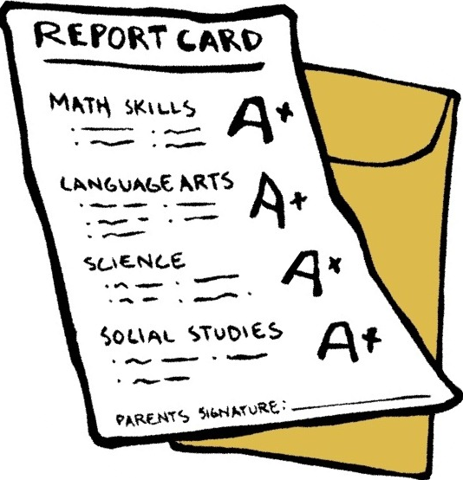
Transcripts
Common Application- Link your counselor’s email address, your counselor will then upload the transcript for you (free)
In State Schools- www.cfnc.org (free)
Out of State Schools or Scholarships- www.wcpss.net/transcipts (1st 3 are free)
Quick links- Toward the bottom on right side of the main Athens site

Slide 20
Financial Aid
FAFSA- Free Application for Federal Student Aid
Available October 1
Every college has a preferred FAFSA deadline to be considered for scholarships- check with your schools
Ms. Sharpe- Financial Aid FAFSA Advisor, email her or your Counselor to sign up. Tuesday appointments
Never pay someone for a “guaranteed” scholarship or to complete your FAFSA!
FAFSA Help, www.cfnc.org

Slide 21

Scholarship Bulletin
Look on the Athens site under Student Services then Scholarships/Awards. Updated regularly!

Slide 22

Scholarship Criteria
Academic merit
Leadership activities
Community service
Special talents (artistic, athletic etc.)
Honors and achievements
Financial need
Essays

Slide 23

Senior Year To Do List
Take the SAT or ACT in the fall
Visit colleges
Visit www.cfnc.org for college planning
Review your transcript for accuracy
Complete Brag Sheet if you need a recommendation letter from your Counselor
Think about who to ask for letters of recommendation
Apply to colleges
Apply for scholarships
Complete the FAFSA (see Ms. Sharpe)
Complete Residency Determination Form
Keep your grades up (colleges get mid year/final grades)
Take advantage of college representatives that visit Athens

Slide 24


Stay in Touch!
Just For Seniors Site (being updated): https://sites.google.com/wcpss.net/adhscollegeapps/home
Instagram: @athensdrive_studentservices
Twitter: @ADHSStudentSvcs

Slide 25

Congratulations Class of 2023!
Ms. Carlton, our CDC, will now share some information with you
After her presentation you will get a copy of your transcript
Please email your Counselor with questions! We are here to help you!

Slide 26
Career Services
Ms. Carlton, CDC- Career Development Coordinator
mccarlton@wcpss.net

Slide 27
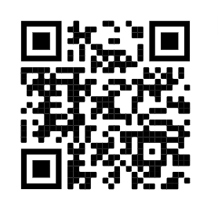
Let’s get some information…
Scan here!

Slide 28

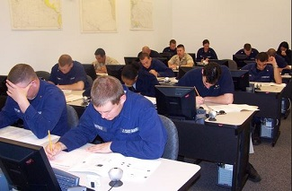
ASVAB: Armed Services Vocational Aptitude Battery
*** Offered at Athens October 5th, 2022 ***
Sign up with me! (Listen for the daily announcement)
Explanation of your scores

Slide 29



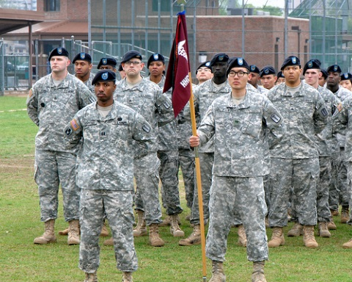


Military Careers
Recruiters answer your questions & provide assistance
  National Guard (SSGT Mitchel Mahnor)
  Marines (SSGT Christopher J. Elseick )
  Navy ( Petty Officer Thomas Kay)
  Army (SSGT Lemos and SSGT Johnson)
  Coast Guard (Joshua Dysart)
  Air Force (MSGT. Jose Pineda)
Pick up contact information in the CAREER CENTER!
This Photo by Unknown Author is licensed under CC BY

Slide 30

Cost Effective, compared to other schools
No SAT or ACT required for admission
  Can waive testing with 2.6 u/w GPA and 4 maths OR SAT/ACT scores
Transfer Options Available (AA, AS, AAS)
1-Year, 2-year, and Certificate options
Ally Pearsall--Admissions representative for Athens (anpearsall@waketech.edu)
Wake Tech Open House: October 15th, 9 am-12 pm; Register here!
College Connect: Tour Wake Tech’s Campus on November 2nd see Ms. Carlton ( if interested in attending)

Slide 31
Explore Your Interests
Job Shadow (spend a day observing/following a career professional)
Internship (short term usually 4-6 weeks)
Volunteer at a business/company
Part-time Employment Fair coming October 19th!
Participate in career fairs to network and make connections
Ask questions of someone working in the industry/field

Slide 32


Apprenticeship Opportunities
Over $150,000 investment in each apprentice.
Earn $ while you learn!
NC TAP representative will visit Athens Drive this fall to explain the program and benefits and how to apply.
Listen to announcements for date and then sign up in career center to attend info session See Ms. Carlton for more information.
NCTriangle Apprenticeship Program ... the degree that pays ... the other four-year degree

Slide 33
Pre-requisites for NC-Triangle Apprenticeship Program
You have attended one or more NCTAP open houses.
Current junior or senior
GPA of 2.8 or higher.
Completion of Physics, Drafting/CAD & computer applications are desired.
Foreign language knowledge will be an asset for today's global economy.

Slide 34

Thank you!

